Slide 1
2026 FIFA World Cup Predictions
Joshua Gray
Vaijayanti Shrikant Deshmukh
Lasya Raghavendra

Slide 2
Scope of Project
This project aims to design and deploy an AWS-based machine learning environment capable of predicting the next FIFA World Cup champion using historical and contemporary football data.
Processes 48,000+ international football matches (1872-2025) through a modern data pipeline
Trains an ML model to predict match outcomes
Uses that model to simulate knockout tournaments with Monte Carlo simulations
All implemented with cloud architecture

Slide 3
Data Sources
International football results from 1872 to 2025 (Kaggle)
Dataset tracking match statistics from 1872-2025
48,000 matches recorded
Football Players Data (Kaggle)
Dataset tracking individual player ratings
17,000 players
World Football Elo Rating (eloratings.net)
Tracks elo score of 244 national teams
Last updated on September 15
FIFA Rankings (fifa.com)
Official FIFA rank list
Updated monthly

Slide 4
The Draw Paradox
The Constraint: The Official Draw is on Dec 5th. Until then, we do not know the group configurations or the complete list of qualified teams.
The Implication: Static modeling is impossible. We cannot hard-code matchups.
The Solution:
Implementation of Live Data Collection pipelines.
Dynamic configuration of groups as they are announced.

Slide 5
Predictive Methodology
Monte Carlo Simulation
Instead of predicting a single winner, we will simulate the entire tournament X times (e.g., 10,000 runs). This accounts for the inherent randomness of the sport.
A team's "Strength" is calculated based on the percentage of simulations where they reach the top ranks (Semi-Finals, Finals, Champion).

Slide 6
Architectural Pivot
From VPC Peering to IAM Users
Initial Plan: Use VPC Peering and mount a shared Elastic File System (EFS) across all three accounts.
The Issue: We encountered significant instability and complexity with cross-account EFS mounting and permissions.
The Solution: We migrated to a robust IAM User-based architecture.

Slide 7
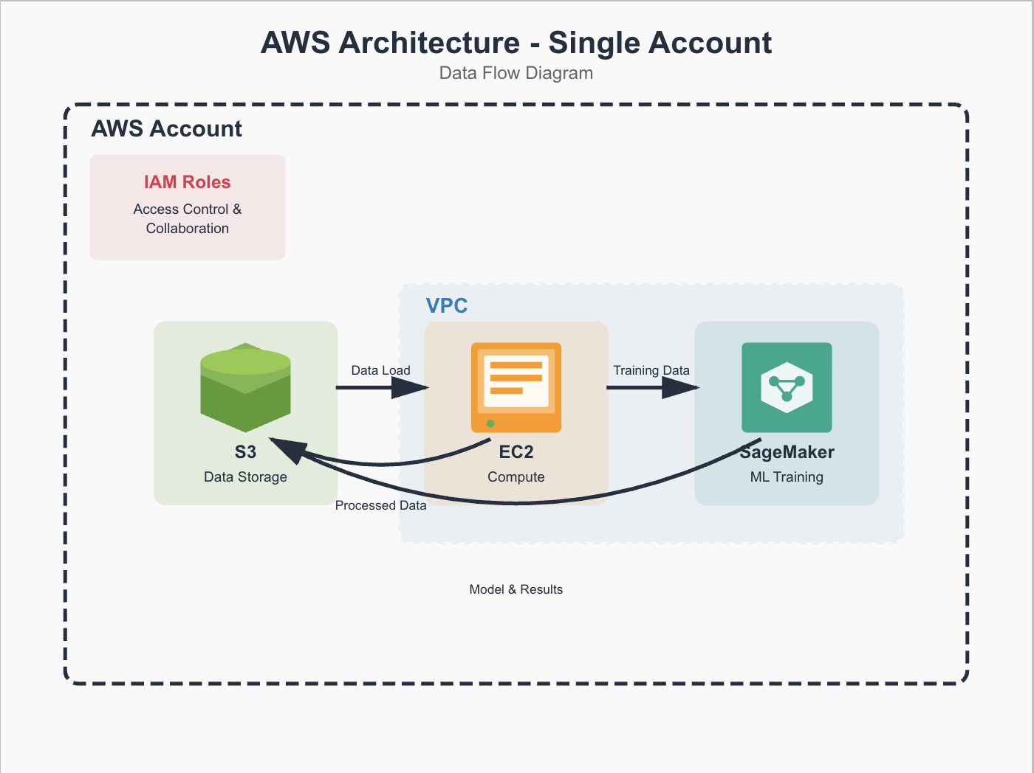
AWS Architecture

Slide 8
Github links!
https://github.com/lasyagowda07/football-sim-backend- https://github.com/lasyagowda07/football-sim-frontend

